Slide 1
Photorealistic Rendering of Training Data for Object Detection and Pose Estimation Presented by Wessam Frrag Supervised by Fabian Manhardt Johanna Wald Advisor Federico Tombari TUM department of informatics Chair for Computer Aided Medical Procedures & Augmented Reality Kick off Bachelor thesis

Slide 2
Introduction

Slide 3
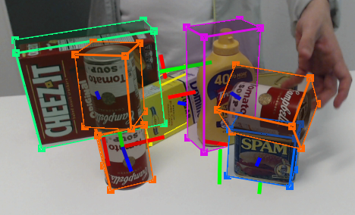
Pose estimation
Tremblay, J., To, T., Sundaralingam, B., Xiang, Y., Fox, D. and Birchfield, S., 2018. Deep object pose estimation for semantic robotic grasping of household objects. arXiv preprint arXiv:1809.10790.
A computer vision problem in which we predict the pose of objects given an RGB image.

Slide 4
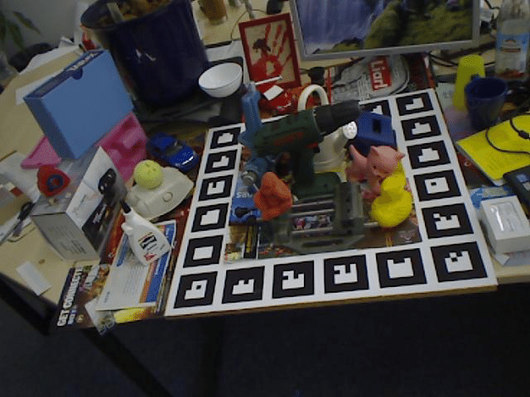
Using real data for training.
PVNet Peng, S., Liu, Y., Huang, Q., Zhou, X. and Bao, H., 2019. PVNet: Pixel-wise Voting Network for 6DoF Pose Estimation. In Proceedings of the IEEE Conference on Computer Vision and Pattern Recognition (pp. 4561-4570).
BB8 Rad, M. and Lepetit, V., 2017. BB8: A scalable, accurate, robust to partial occlusion method for predicting the 3D poses of challenging objects without using depth. In Proceedings of the IEEE International Conference on Computer Vision (pp. 3828-3836).
PoseCNN Xiang, Y., Schmidt, T., Narayanan, V. and Fox, D., 2017. Posecnn: A convolutional neural network for 6d object pose estimation in cluttered scenes. RSS 2018.
From LINEMOD Dataset

Slide 5
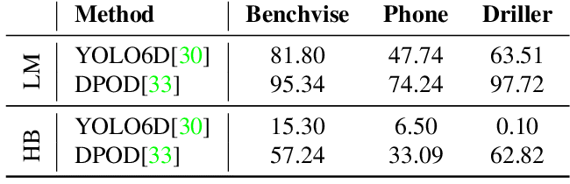
Why real data does not work for training.
It is hard to annotate data manually and takes a lot of time.
Pose estimation is a complex task that needs a lot of data for training.
Solution.
Using synthetic data.
HomebrewedDB
Kaskman, R., Zakharov, S., Shugurov, I. and Ilic, S., 2019. HomebrewedDB: RGB-D Dataset for 6D Pose Estimation of 3D Objects. arXiv preprint arXiv:1904.03167.

Slide 6
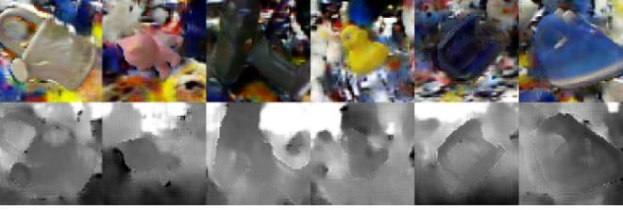
Challenges with synthetic data.
The domain gap between synthetic data and real data.
Networks trained on synthetic data overfits and is hard to generalize without using other techniques.
Bousmalis, K., Silberman, N., Dohan, D., Erhan, D. and Krishnan, D. Unsupervised pixel-level domain adaptation with generative adversarial networks. CVPR 2017.

Slide 7
Related Work

Slide 8
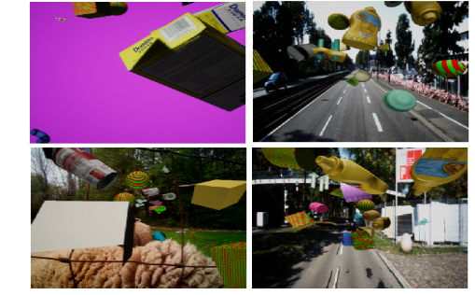
Domain Randomization
Examples
DeceptionNet: Zakharov, S., Kehl, W. and Ilic, S., 2019. DeceptionNet: Network-Driven Domain Randomization. arXiv preprint arXiv:1904.02750.
Tobin, J., Fong, R., Ray, A., Schneider, J., Zaremba, W. and Abbeel, P., 2017, September. Domain randomization for transferring deep neural networks from simulation to the real world. In 2017 IEEE/RSJ International Conference on Intelligent Robots and Systems (IROS) (pp. 23-30). IEEE.
Tremblay, J., To, T., Sundaralingam, B., Xiang, Y., Fox, D. and Birchfield, S., 2018. Deep object pose estimation for semantic robotic grasping of household objects. arXiv preprint arXiv:1809.10790.
Deep object pose estimation for semantic robotic grasping of household objects

Slide 9
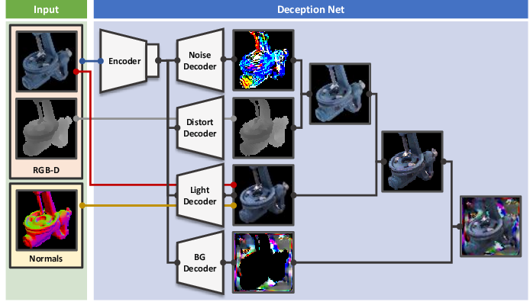
DeceptionNet

Slide 10
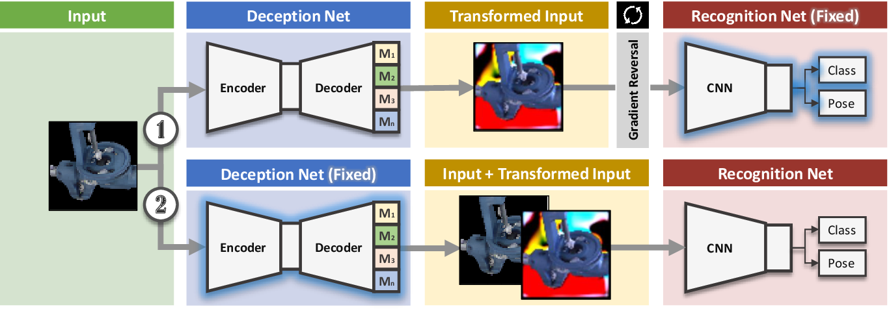
DeceptionNet

Slide 11
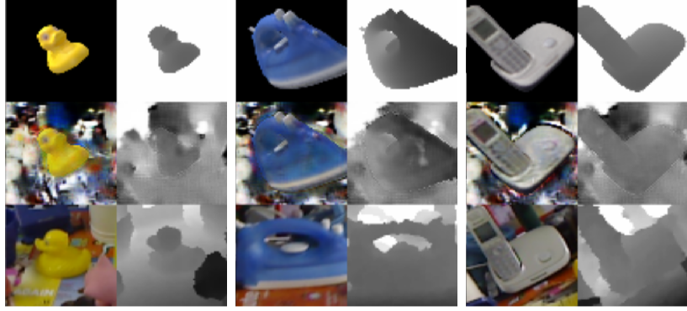
Domain Adaptation
Examples:
DANN: Ganin, Y., Ustinova, E., Ajakan, H., Germain, P., Larochelle, H., Laviolette, F., Marchand, M. and Lempitsky, V., 2016. Domain-adversarial training of neural networks. The Journal of Machine Learning Research, 17(1), pp.2096-2030.
GANs: Bousmalis, K., Silberman, N., Dohan, D., Erhan, D. and Krishnan, D., 2017. Unsupervised pixel-level domain adaptation with generative adversarial networks. In Proceedings of the IEEE conference on computer vision and pattern recognition (pp. 3722-3731).
Unsupervised pixel-level domain adaptation with generative adversarial networks.

Slide 12
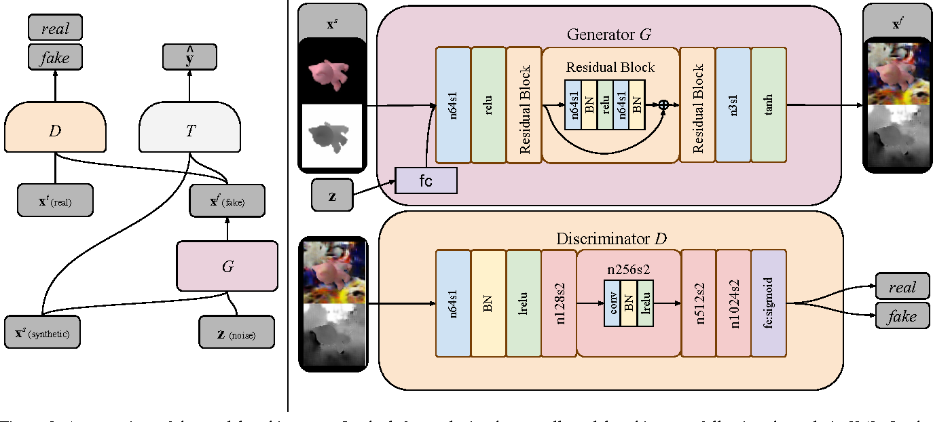
GANs Approach

Slide 13
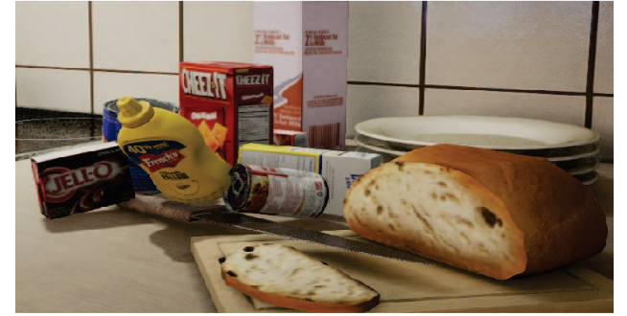
Photorealistic Rendering
Falling Things
Examples:
Hodan, T., Vineet, V., Gal, R., Shalev, E., Hanzelka, J., Connell, T., Urbina, P., Sinha, S.N. and Guenter, B., 2019. Photorealistic Image Synthesis for Object Instance Detection. arXiv preprint arXiv:1902.03334.
Tremblay, J., To, T. and Birchfield, S., 2018. Falling Things: A synthetic dataset for 3D object detection and pose estimation. In Proceedings of the IEEE Conference on Computer Vision and Pattern Recognition Workshops (pp. 2038-2041).

Slide 14
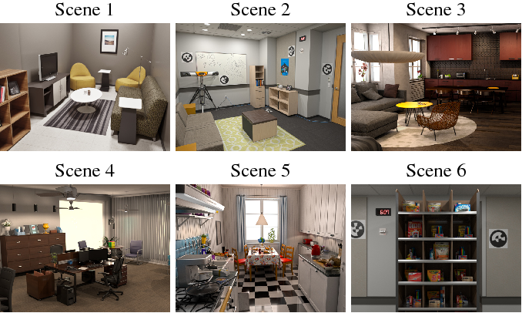
Photorealistic Image Synthesis for Object Instance Detection.
Approach:
Using High definition meshes of 15 objects and 6 scenes.
Arranging objects in physically plausible arrangements using nvidia physx.
Physically Based Rendering (PBR) using Arnold Renderer.

Slide 15
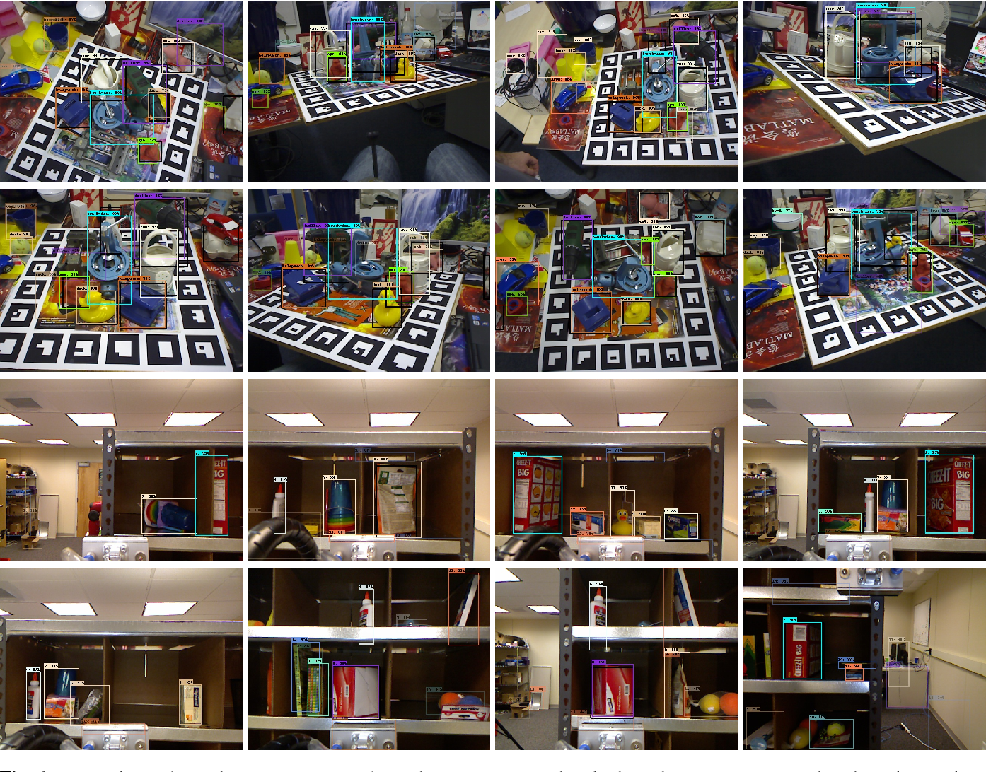

Slide 16
Our Approach
Physical plausible poses.
Physically based rendering.
Blending rendered objects with real images.

Slide 17
Challenges
Minimizing domain gap between rendered objects and the real images of the scene.
Rendering objects by the right parameters of the real camera poses.

Slide 18
Advantages
Tackling the domain gap by using real images instead of rendered scenes.
Low cost of computation since we are not rendering the whole scene.

Slide 19
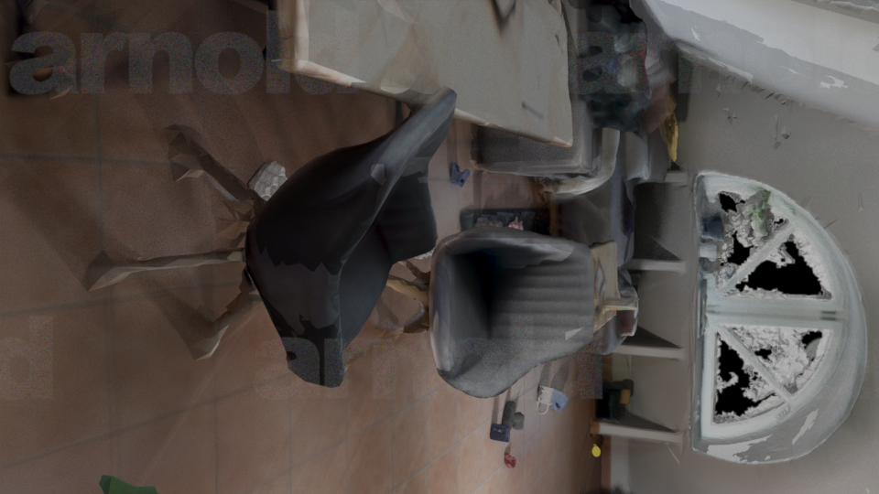

Slide 20
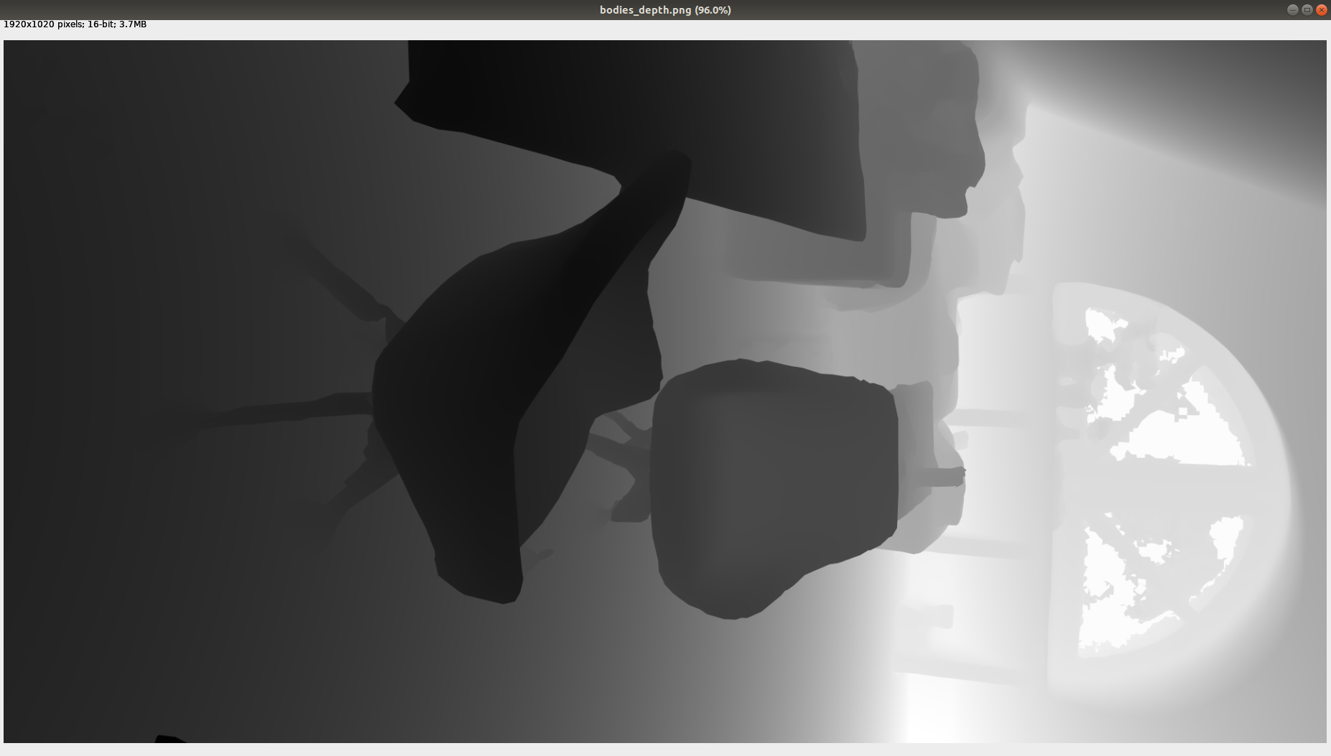

Slide 21
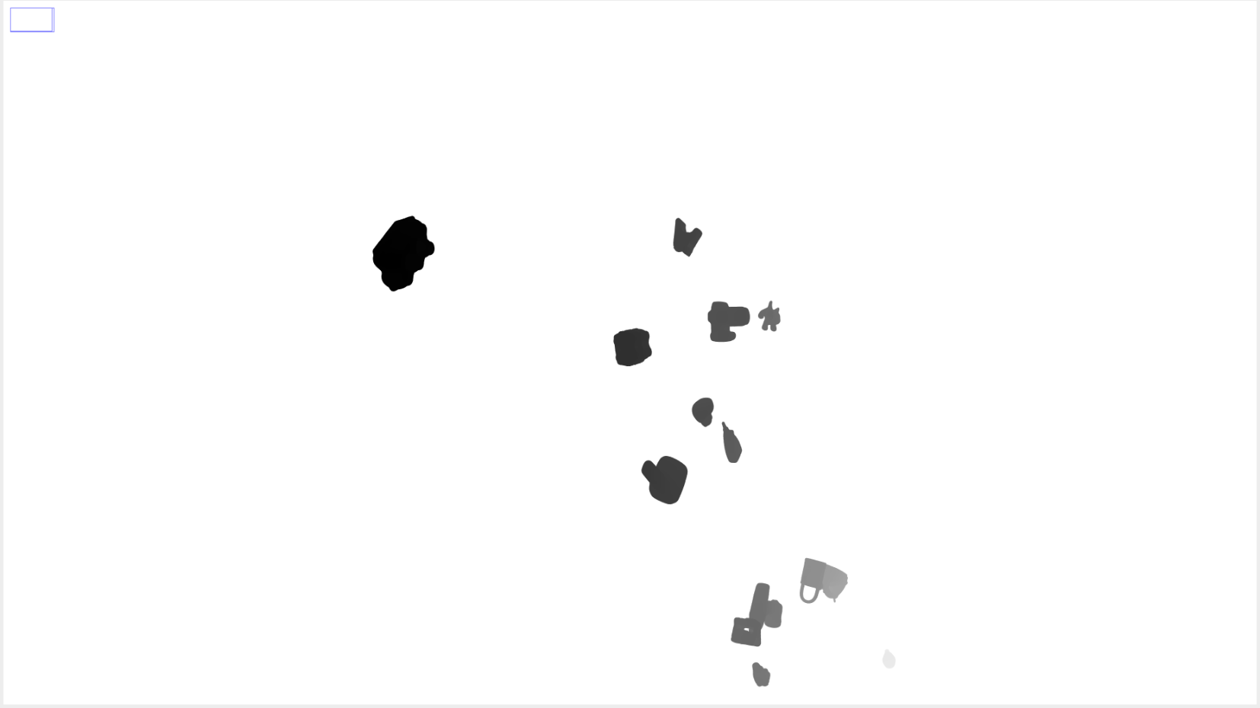

Slide 22
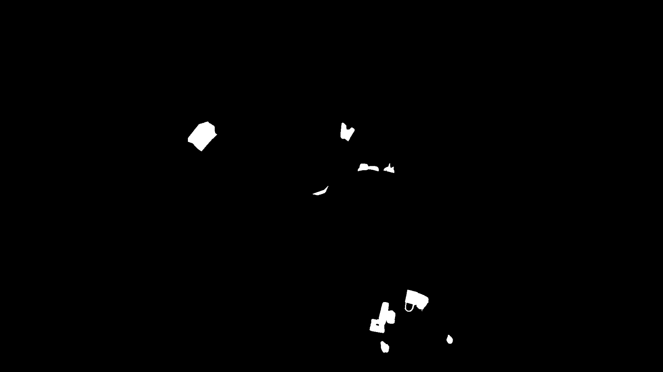

Slide 23
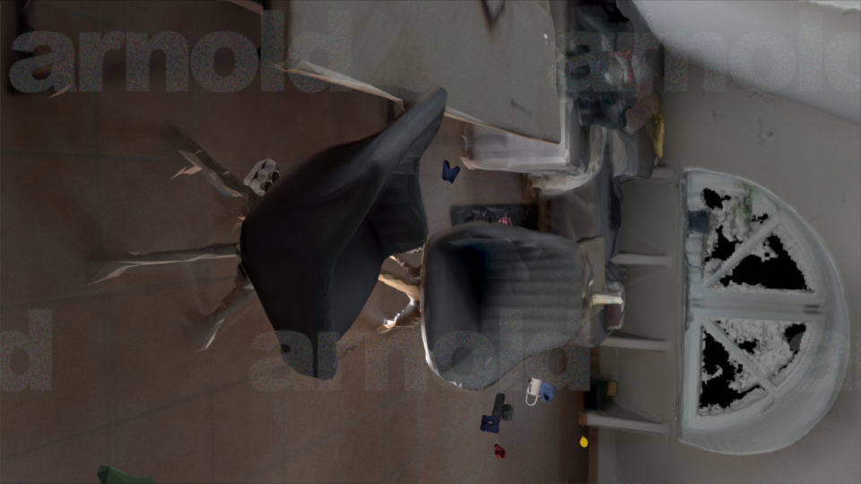

Slide 24
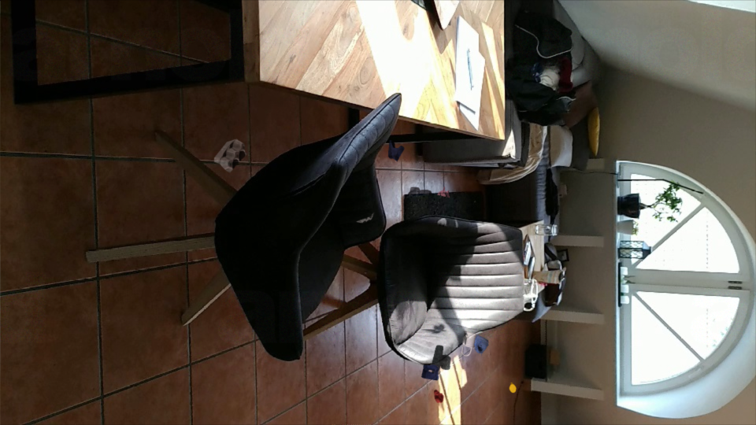

Slide 25
Thank you

